Slide 1
Japheth Gordon
ARTICLE SUMMARY
ORGANIZER
AI-Powered Knowledge Management Automation
Capstone Project | TripleTen Program

Slide 2
THE PROBLEM 📚
Information Overload 😰
📖 Articles, books, and research pile up constantly
🔍 Key insights get buried and forgotten
🤷 No system to separate actionable vs. reference content
⏱️ Manual summarization takes 2-3 hours per week

Slide 3
THE SOLUTION 💡
Automated Knowledge Management System 🚀
✓ 📝 Submit articles via Google Form
✓ 🤖 AI extracts key takeaways and action items
✓ ⚡ Smart routing: Actionable articles trigger email alerts
✓ 📊 Everything organized in searchable Google Sheets

Slide 4
TIME SAVED & EFFICIENCY ⏰
BEFORE 😫
AFTER 🎉
⏱️ 15-20 min
per article to read and summarize
📝 10 min
to manually organize notes
🔍 5-10 min
to find notes later
Total: 2-3 hours/week
⚡ 30 seconds
to submit article to form
🤖 Automated
AI extraction and categorization
🔍 Instant
searchable database
Total: ~3 min/week

Slide 5
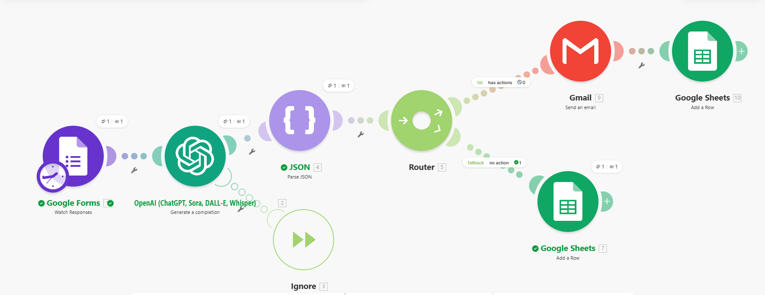
WORKFLOW ARCHITECTURE 🔧
PLACEHOLDER: Insert screenshot of Make.com workflow diagram here
Google Forms → OpenAI → Parse JSON → Router → Gmail + Google Sheets

Slide 6
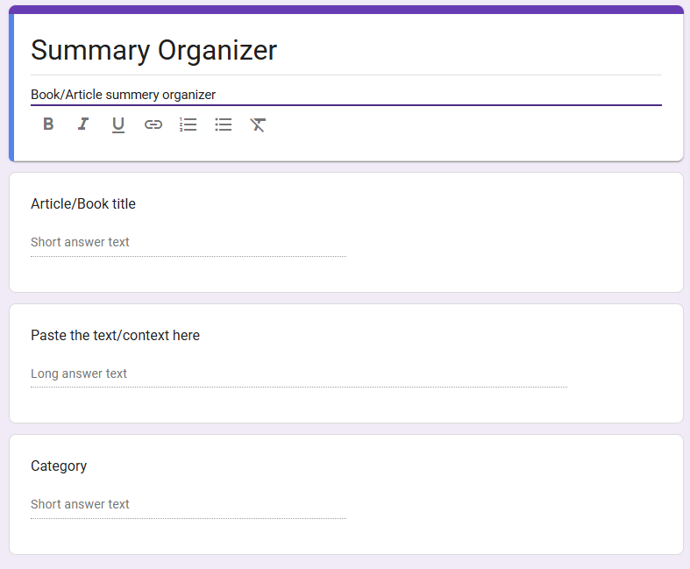
INPUT: GOOGLE FORM 📝
Article title, Category, Content text fields

Slide 7
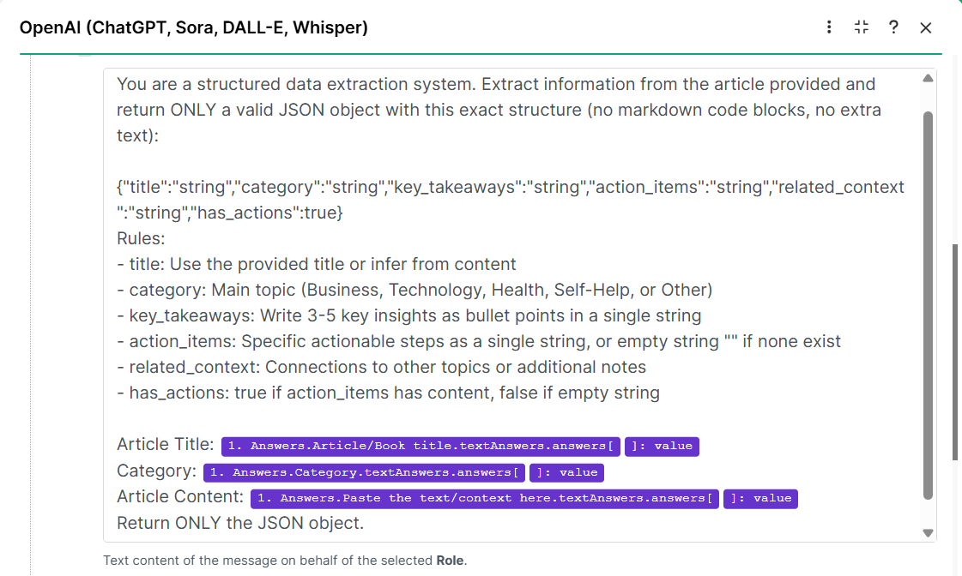
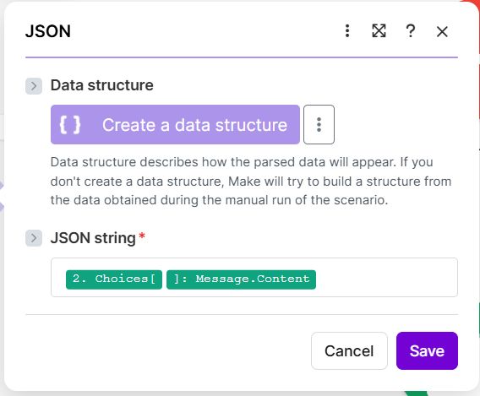
AI PROCESSING 🤖
Structured JSON with title, category, key_takeaways, action_items, has_actions

Slide 8
INTELLIGENT ROUTING 🚦
PATH 1 ⚡
PATH 2 📚
Actionable Articles
Reference Articles
✓ has_actions = true
📧 Send Gmail alert
📊 Add to Sheets
✓ has_actions = false
🔕 No alert needed
📊 Add to Sheets

Slide 9
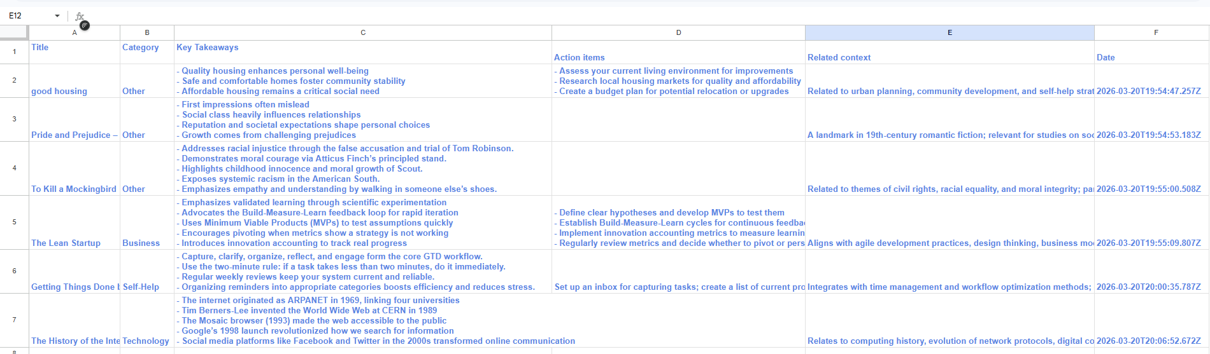
OUTPUT: ORGANIZED KNOWLEDGE BASE 📊
Separate columns for Title, Category, Key Takeaways, Action Items, Context, Date

Slide 10
RESILIENCE & ERROR HANDLING 🛡️
Production-Ready Architecture 🏗️
Error Handler on OpenAI Module 🔧
• Catches API timeouts and rate limits
• Uses 'Ignore' directive to prevent scenario crashes
• Logs failures for review and reprocessing
Why This Matters ⭐
• AI APIs are the primary failure point
• Prevents data loss from failed processing
• Ensures automation runs reliably without supervision

Slide 11
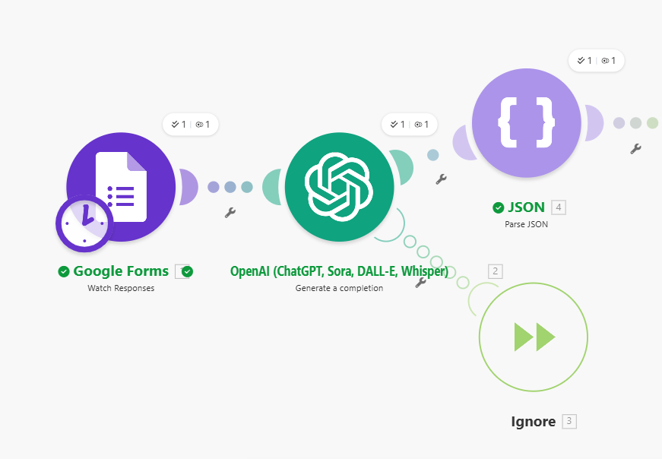
ERROR HANDLER SETUP ⚙️
Error handler on OpenAI module with 'Ignore' directive

Slide 12
REFLECTION 💭
1
The Process I Automated
Reading and summarizing articles and books is essential for professional development, but manually extracting key insights and organizing them takes 2-3 hours per week. I automated the entire workflow: article submission, AI-powered analysis, intelligent categorization, and structured storage. Now what took hours happens in seconds. ⏱️→⚡

Slide 13
REFLECTION 💭
2
Why It Matters
Knowledge management is a competitive advantage. This system ensures I never lose valuable insights, actionable items get immediate attention instead of getting buried, and I can search my entire knowledge base in seconds. It transforms reading from passive consumption into an active learning system that compounds over time. 📈

Slide 14
REFLECTION 💭
3
How AI Improved It
AI doesn't just save time—it adds intelligence. The structured JSON extraction ensures consistent formatting across all articles. The Router makes smart decisions based on content analysis, automatically prioritizing actionable insights. Without AI, this would require manual reading, subjective categorization, and time-consuming data entry. AI transforms it into a scalable, consistent, intelligent system. 🤖✨

Slide 15
REFLECTION 💭
4
Next Steps & Improvements
🌐 Add URL scraping to extract article text directly from links
💬 Integrate with Slack for team knowledge sharing
🎯 Add sentiment analysis to flag controversial or biased content
📧 Build a monthly digest email with top insights
🏢 Create a public-facing version for organizational knowledge management

Slide 16
KEY TAKEAWAYS 🎯
98% ⏱️
2 🚦
24/7 🛡️
Time Saved
Decision Paths
Resilience
~3 min vs 2-3 hours/week
Router logic for intelligent processing
Error handling prevents data loss

Slide 17
THANK YOU! 🙏
Questions? 💬
Article Summary Organizer | Capstone Project

